Slide 1
Define Privacy Protection and Law.
Submitted By: -
Ekhlakh Ahmad
Reg. No 12209166
Roll No RD2215B50

Slide 2

What is Privacy Protection and Law?
Why is Privacy Protection and Law Important?
What Does Privacy Protection and Law Cover?
Who is Responsible for Enforcing Privacy Protection and Law?
What Are the Consequences of Violating Privacy Protection and Law?
Physical Security
Encryption
Digital Signature
Conclusion

Slide 3
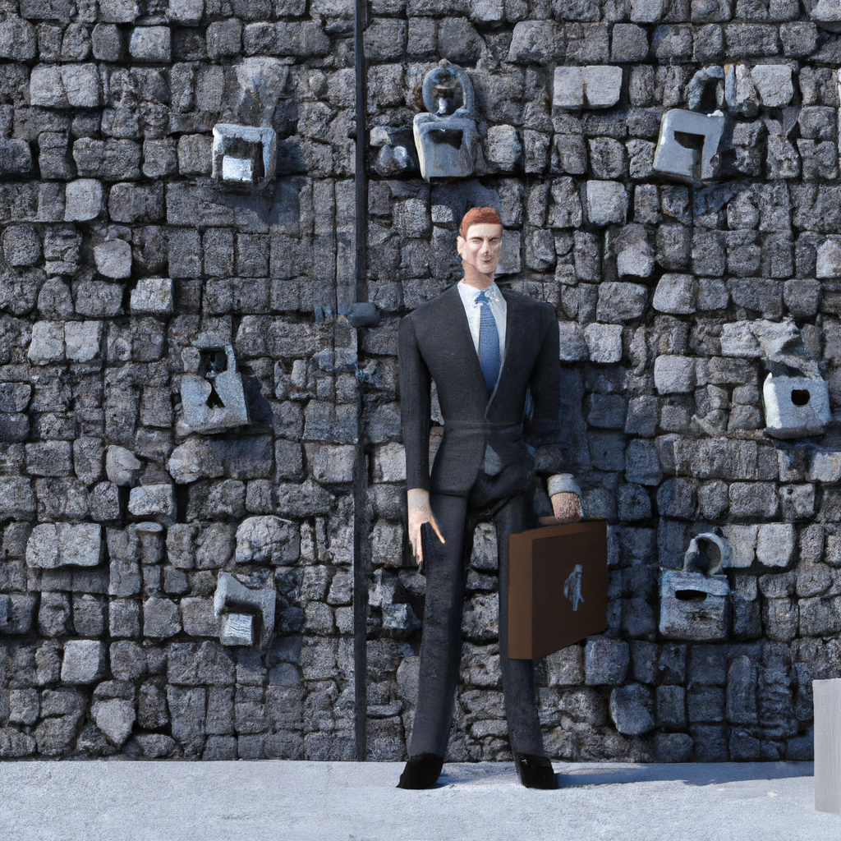
What is Privacy Protection and Law?
Privacy protection and law is a set of rules and regulations that protect an individual's right to privacy. It is a legal framework that sets out the limits on what information can be collected and used, and how it can be used. It also includes laws that protect personal information from being shared without permission.
The purpose of privacy protection and law is to ensure that individuals have control over their personal information and how it is used. It is also intended to protect individuals from having their information misused or shared without their consent. This includes preventing the unauthorized disclosure or use of personal data.

Slide 4
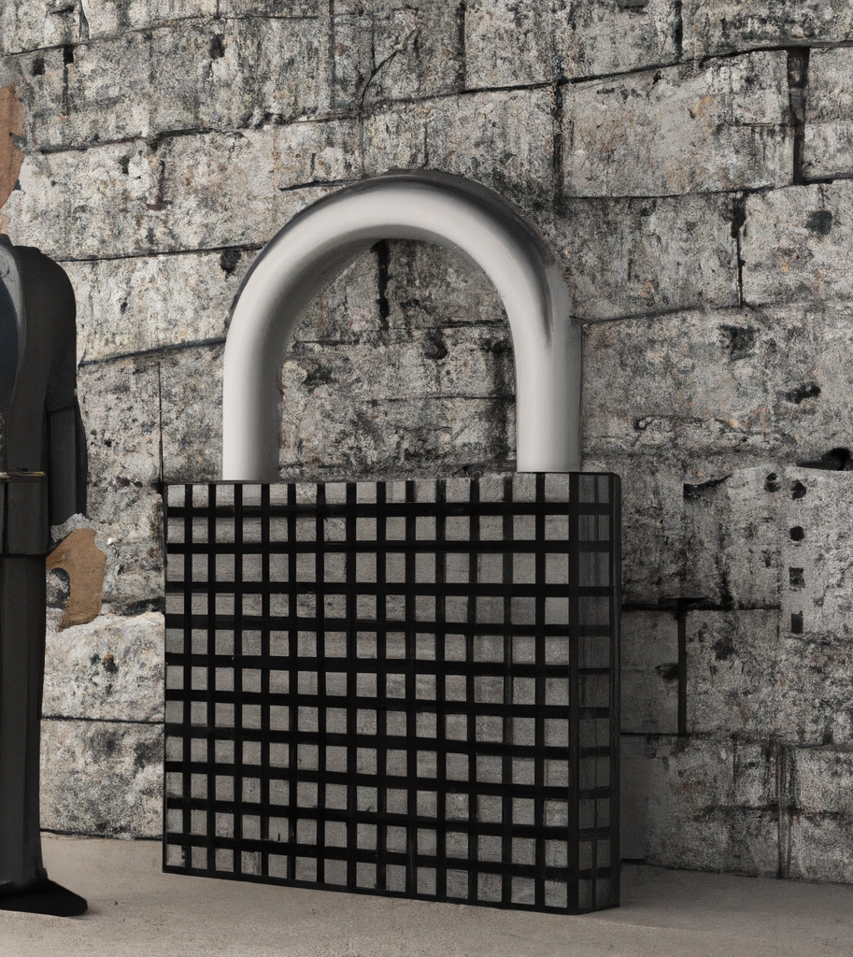
Why is Privacy Protection and Law Important?
Privacy protection and law is important because it helps to protect individuals' personal information from being misused or shared without their consent. It also helps to ensure that individuals have control over how their personal information is used. This is especially important in a world where data is increasingly being collected and shared.
Privacy protection and law is also important because it helps to ensure that individuals are not discriminated against or exploited based on their personal information. This includes preventing employers from using personal information to make decisions about hiring, promotions, or other employment-related matters.

Slide 5

What Does Privacy Protection and Law Cover?
Privacy protection and law covers a wide range of topics, including the collection, use, and disclosure of personal information. It also covers the storage and security of personal information, as well as the right to access and correct personal information. Additionally, it covers the right to be informed about how personal information is used and to whom it is disclosed.
Privacy protection and law also covers the right to opt-out of certain uses of personal information, such as marketing, and the right to be informed of any changes to privacy policies. It also covers the right to complain to a regulator if an individual feels that their privacy rights have been violated.

Slide 6
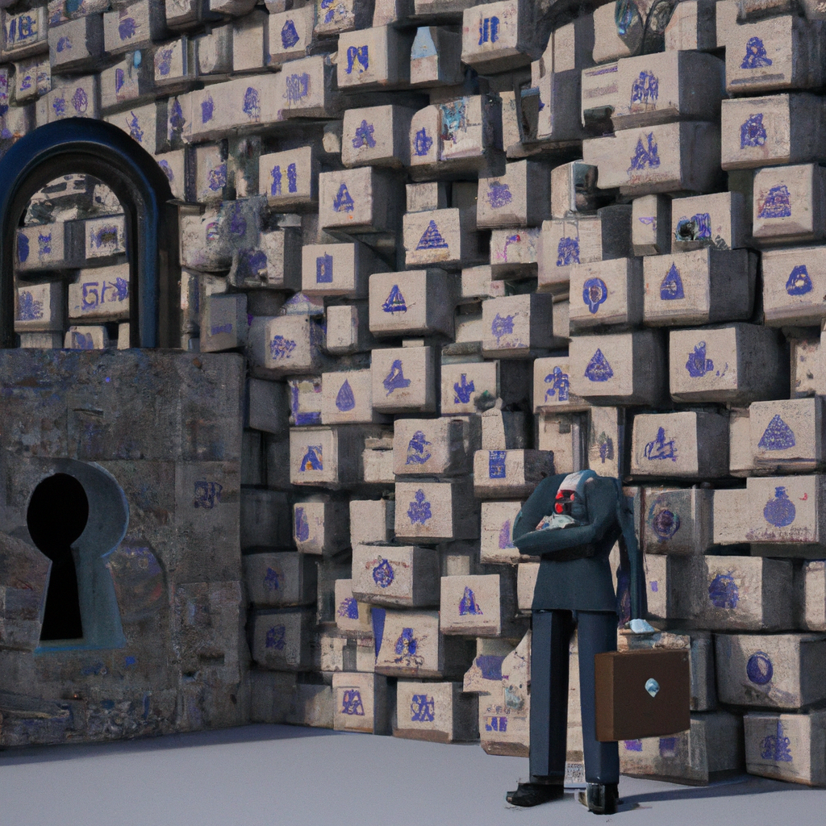
Who is Responsible for Enforcing Privacy Protection and Law?
The enforcement of privacy protection and law is typically the responsibility of a national or regional data protection authority. These authorities are responsible for ensuring that organizations comply with privacy laws and regulations. They are also responsible for investigating complaints and taking action against organizations that are found to be in violation of privacy laws.
In some countries, such as the United States, there are also private organizations that are responsible for enforcing privacy protection and law. These organizations are typically non-profit and work to ensure that individuals' privacy rights are respected and protected.

Slide 7

What Are the Consequences of Violating Privacy Protection and Law?
The consequences of violating privacy protection and law can vary depending on the country or region. In some cases, violations may result in fines or other penalties. In other cases, organizations may be required to make changes to their policies and procedures in order to comply with the law. In extreme cases, organizations may face criminal charges.
It is important to note that violations of privacy protection and law can also have a negative impact on an organization's reputation. This can lead to a loss of customers and a decrease in revenue, as well as an increase in public scrutiny and criticism.

Slide 8
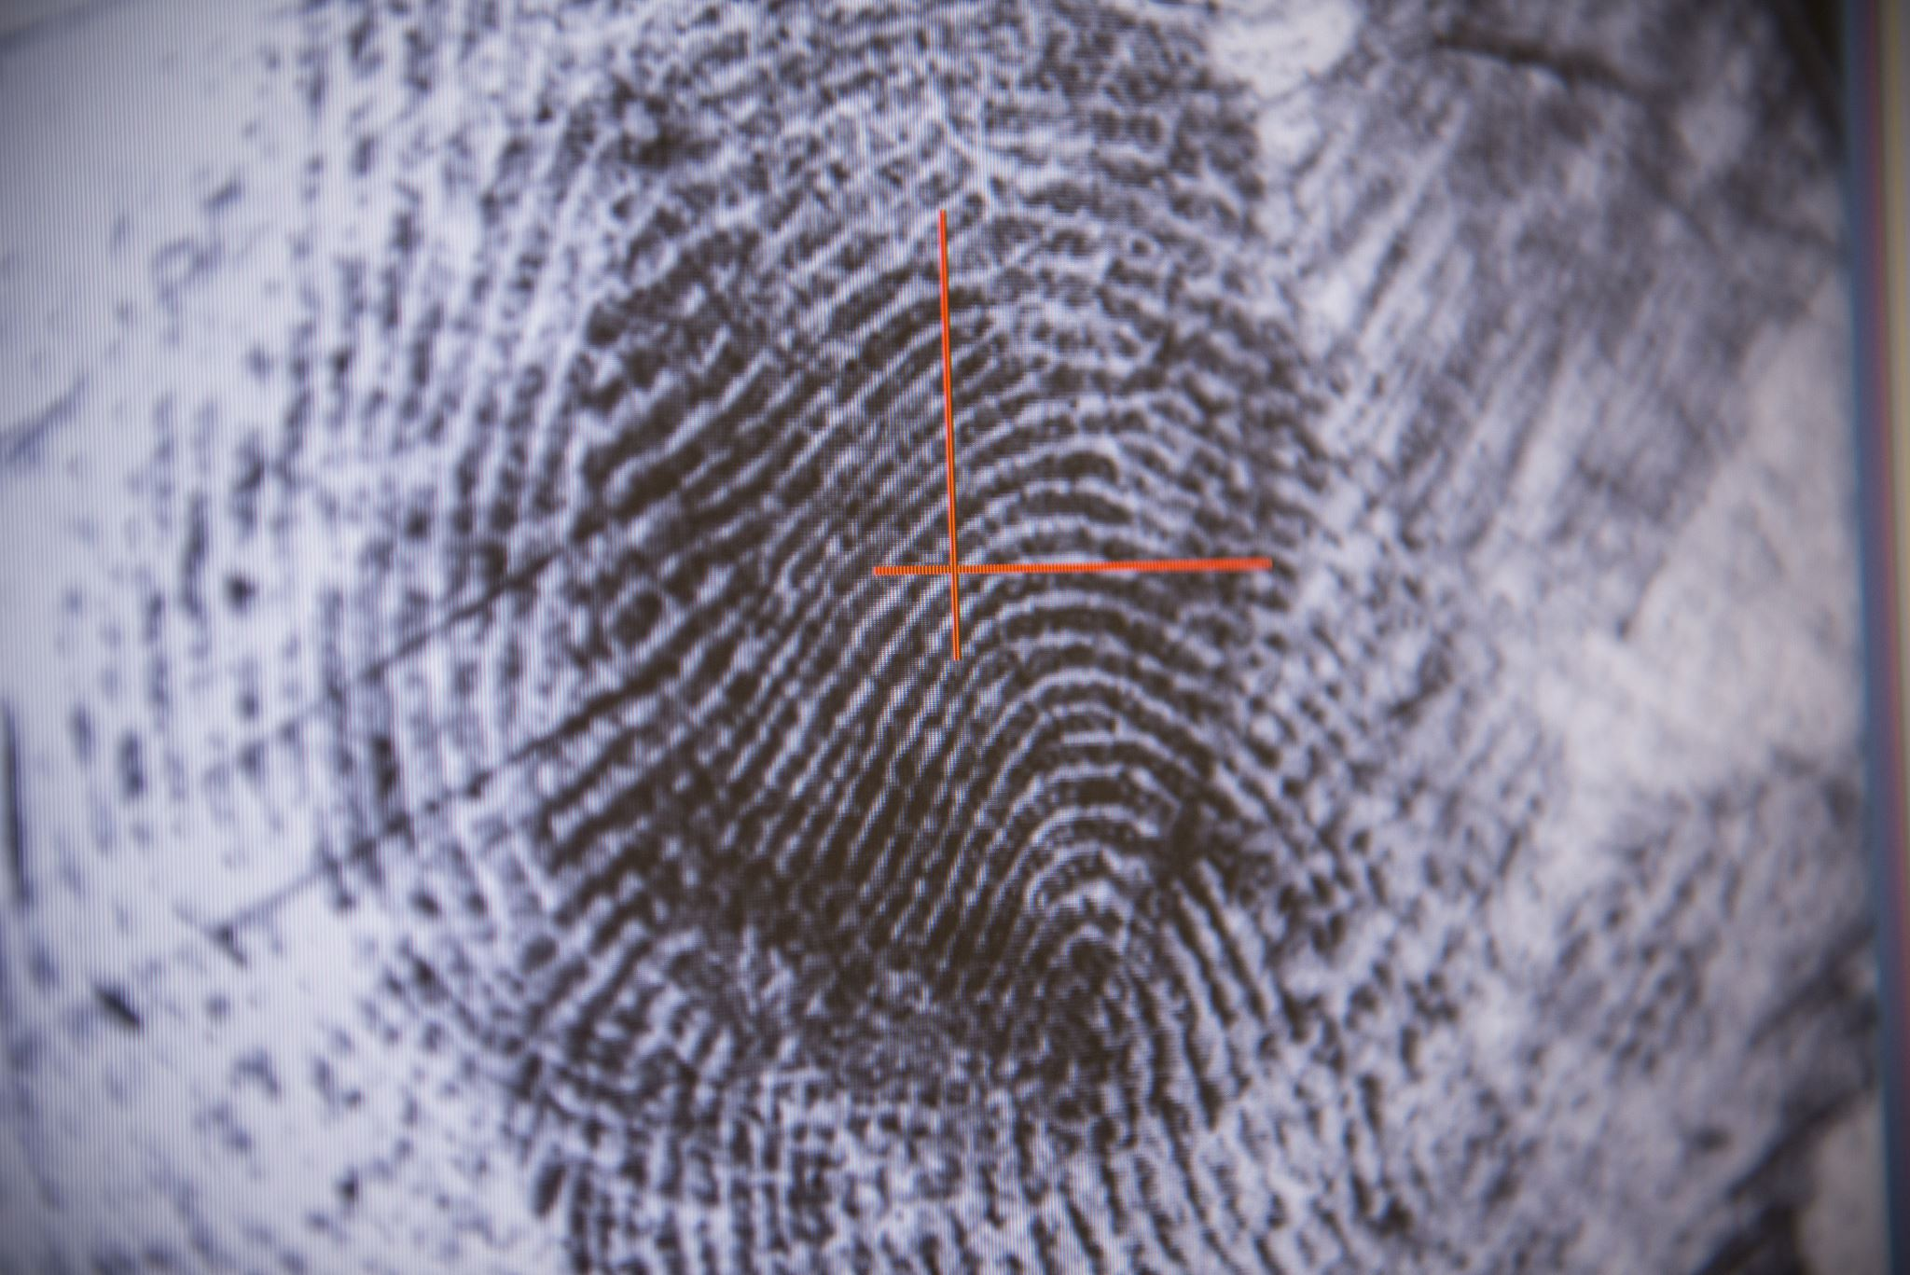
Physical Security
The most obvious choice of protecting data is to keep it in a safe locked room/building
Protected rooms can e safeguarded by
A lock-and-key
ID card scanning
Biometrics (retina-scan, fingerprint-scanning)
Using a safe Alarms

Slide 9

Encryption
Encryption makes data in a computer system illegible and makes data look meaningless
Decryption is converting the illegible data back into its original form
An encryption key is a code used for the encryption process
A decryption key is needed before the data can be changes back to its original form

Slide 10

Digital Signature
A digital signature makes used of encrypted data
A digital signature is encrypted data used to show that the data being sent or read it genuine
If the recipient of the data can correctly decrypt the digital signature then the data should be correct

Slide 11
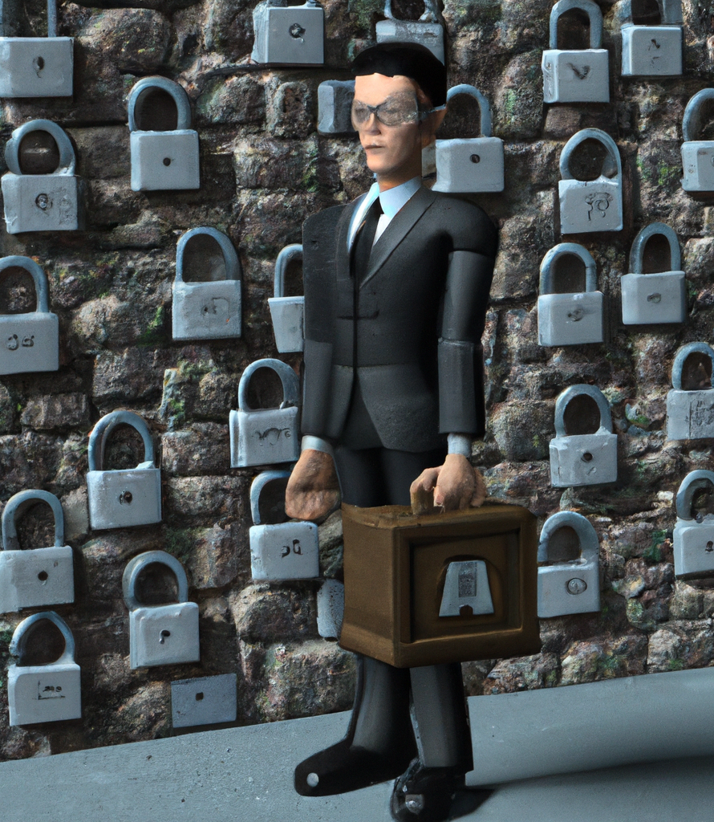
Conclusion
Privacy protection and law is an important set of rules and regulations that protect an individual's right to privacy. It is important to ensure that organizations comply with these laws in order to protect individuals' personal information and ensure that their privacy rights are respected and protected.
It is also important to be aware of the consequences of violating privacy protection and law, as it can have a negative impact on an organization's reputation and lead to fines or other penalties. It is therefore essential for organizations to ensure that they are compliant with privacy laws and regulations

